Slide 1

Faculty Evaluation Analysis Optimization
Andrew Taylor

Slide 2

Disclosure
The names in the dataset have been anonymized.

Slide 3

Summary
The department of pediatrics uses faculty evaluation completion rates as an incentive for faculty compensation. Faculty should be regularly made aware of how they are performing, in order to compete for their incentive.
It is fair that each faculty is emailed when they have a few incomplete evaluations, or when they they are underperforming.

Slide 4
The Problem
Some faculty are not completing evaluations for trainees in a timely manner, and one of their incentives depend on their timely completion. There has been a lapse in the ability to efficiently compile and report this data on a weekly basis. The data cleaning and aggregation process is manually done in excel, across 30 excel files, and is incredibly time consuming, tedious, and error prone. There has been no reproducible framework in place to optimize the project.

Slide 5
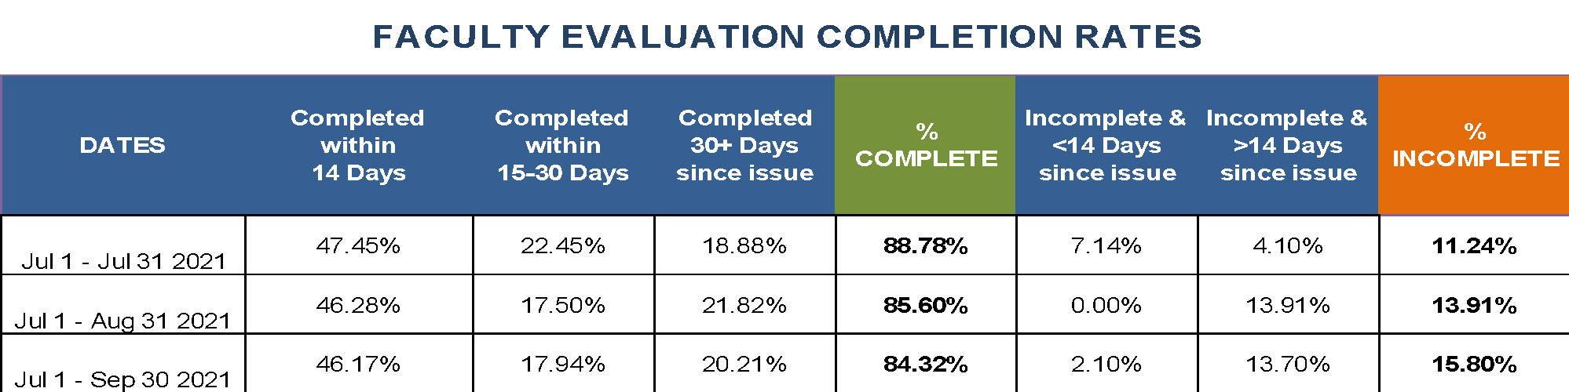
The Intervention
Upon hearing my manager briefly talk about this grueling process she was taking part in, where she would manually tally data points across multiple files in order to complete a single compiled report, I became curious. She briefly showed me one of the excel files she was working with, which had many sheets, and she showed me the result she strived for each week. Upon seeing the desired finished product (pictured here), I knew my skills would be perfect for this task. I asked to set up a meeting to discuss this project more in depth…

Slide 6
The Intervention pt 2.
During our one-on-one meeting, I was much more of a consultant. I was learning and asking questions about what product she wanted, why she wanted it, how she wanted it, and when she wanted it. After vividly envisioning how my skills could impact this data cleaning/aggregation process, I know could make it more efficient, and even take it off of her plate completely.
I assured her that I could regularly and efficiently recreate this spreadsheet, and may even be able to provide visuals. I would later confirm, once I gained familiar with the dataset.

Slide 7
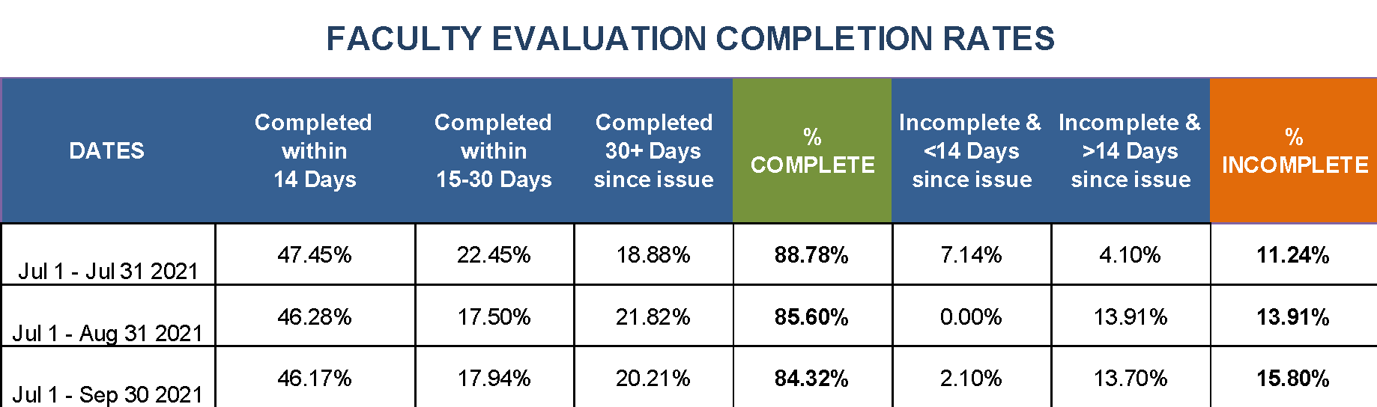
Expectations
Remove certain evals that shouldn’t be considered for faculty incentives
Recreate the file that was made previously (below)
Remove “Dr.” from all names (nice to have)

Slide 8

My Ideas
There was much more to be explored than what was in the soon-to-be former finished product. I thought valuable insights would include:
Number of evaluations by academic unit
Number of evaluations by faculty member
Average time to complete evaluations by faculty
Average time to complete evaluations by academic unit
Visualizations
Automatic conditional emails

Slide 9

Roadblocks
An issue I ran into was not being able to use Selenium, a web driver, to automate clicking through Yale’s secured evaluation website, MedHub, and downloading the files. I am restricted from downloading the 30 files in a loop (see video). This prevents me from fully automating the process. Currently, manually clicking through the website and downloading the 30 files is now the time-consuming portion of this analysis. Waiting on an update from IT. Still, a MUCH swifter process than before.
And even better… I learned a lot about Selenium!

Slide 10
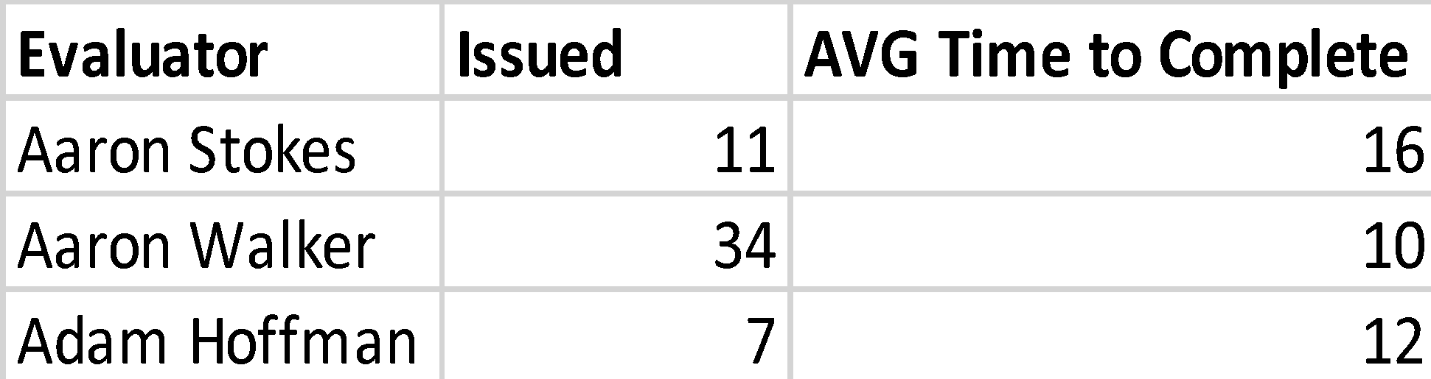
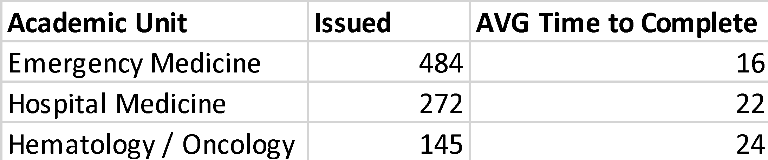
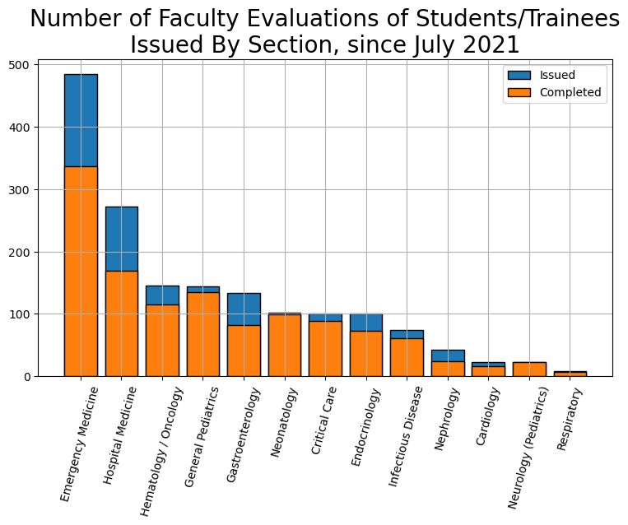
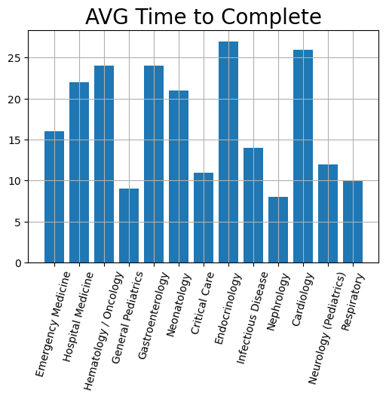
Solutions
Faculty Stats Since July 2021
I utilize Python to create a few, straight forward, easy to digest statistics and visualizations.
I also have a Python function to send emails to faculty who qualify for reminders.

Slide 11
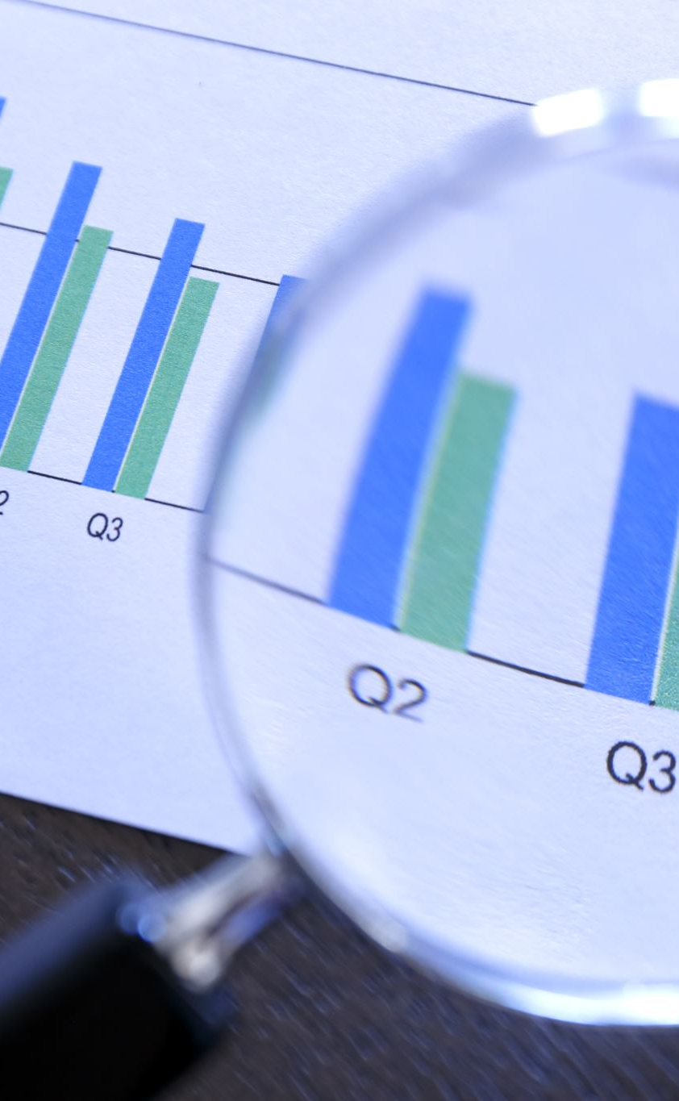
Going Forward…
I have successfully decreased time spent on this process by 95%, from 5 hours per week to 15 minutes.
This project will directly impact faculty evaluation completion rates in an automated fashion.
Notes:
Going forward, the aggregation process for this weekly analysis will include manually downloading the 30 files, saving them to a folder, using the folder as a directory in Python, and running the Python script. The output (clean dataset, visualizations, statistics) will be created within seconds. Conditional emails will be automatically sent to faculty that qualify for reminders.

